Slide 1

RESTful API Design
Design pricipals, demo example implementation

Slide 2

AS-IS
Connectors
AXL
CUCM
Standard Provisioning
Frontend
REST
Backend
REST
Unity
LDAP
Active Directory

Slide 3
TO-BE (many REST, but not the same...)
Connectors
AXL
CUCM
...
Standard Provisioning
Frontend
REST
Backend
REST
Unity
...
LDAP
Active Directory
...
RESTful
APAS
...
RESTful
...
...
RESTful

Slide 4
Why REST?
Lightweight
Simple to use
Standardized operations such as add, delete, and modify
Independent of OS and programming language

Slide 5
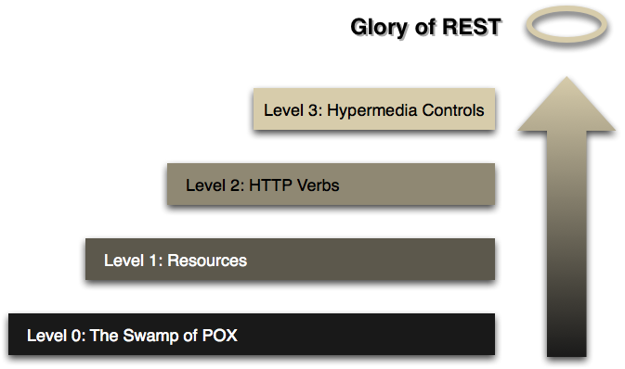
RESTful Maturity Model

Slide 6












Demo Scenario

Slide 7
#1 – Resources
REST level 1: Resources
Examples:
myrest/1/managers
myrest/1/assistants
myrest/1/manager/2
myrest/1/assistant/5

Slide 8
#2 – HTTP Verbs
REST level 2: HTTP Verbs
GET
POST
PUT
DELETE
Other useful operations
PATCH (partial update)
HEAD
OPTIONS
Concept: Safe operation / Idempotent operation

Slide 9
#2 – HTTP Verbs
Header
Accept : application/xml
Accept : application/json
XML drawbacks
Additional annotations for JAXB:
@XmlRootElement
@XmlAttribute
@XmlElement
Element or attribute?
Empty default constructor required
Wrapper for returning lists required

Slide 10
#3 – Hypermedia
...

